Slide 1

Cloud Computing MapReduce in Heterogeneous Environments
Eva Kalyvianaki ek264@cam.ac.uk

Slide 2
Contents
Looking at MapReduce performance in heterogeneous clusters
Material is from the paper:
“Improving MapReduce Performance in Heterogeneous Environments”,
By Matei Zaharia, Andy Konwinski, Anthony D. Joseph, Randy Katz and Ion Stoica, published in Usenix OSDI conference, 2008
and their presentation at OSDI
2

Slide 3
Motivation: MapReduce is becoming popular
Open-source implementation, Hadoop, used by Yahoo!, Facebook, Last.fm, …
Scale: 20 PB/day at Google, O(10,000) nodes at Yahoo, 3000 jobs/day at Facebook
3

Slide 4
Stragglers in MapReduce
Straggler is a node that performs poorly or not performing at all.
Original MapReduce mitigation approach was:
To run a speculative copy (called a backup task)
Whichever copy or original would finish first would be included
Without speculative execution, a job would be slow as the slowest sub-task
Google notes that speculative execution can improve job response times by 44%
Is this approach good enough for modern clusters?
4

Slide 5
Modern Clusters: Heterogeneity is the norm
Cloud computing providers like Amazon’s Elastic Compute Cloud (EC2) provide cheap on-demand computing:
Price: 2 cents / VM / hour
Scale: thousands of VMs
Caveat: less control of performance
Main challenge for Hadoop on EC2 is performance heterogeneity, which breaks task scheduler assumptions
This lecture/paper is on a new LATE scheduler that can cut response time in half
5

Slide 6
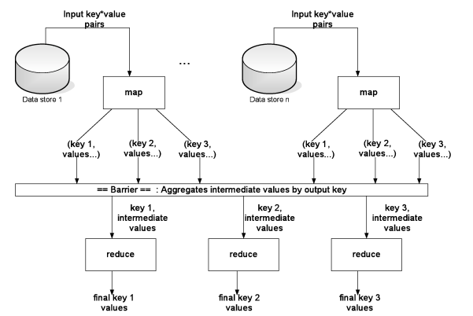
MapReduce Revised
6

Slide 7
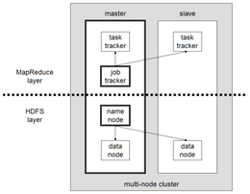
MapReduce Implementation, Hadoop
7

Slide 8
Scheduling in MapReduce
When a node has an empty slot, Hadoop chooses one from the three categories in the following priority:
A failed task is given higher priority
Unscheduled tasks. For maps, tasks with local data to the node are chosen first.
Looks to run a speculative task.
8

Slide 9
Deciding on Speculative Tasks
Which task to execute speculatively?
Hadoop monitors tasks progress using a progress score: a number from 0, …, 1
For mappers: the score is the fraction of input data read
For reducers: the execution is divided into three equal phases, 1/3 of the score each:
Copy phase: percent of maps that output has been copied from
Sort phase: map outputs are sorted by key: percent of data merged
Reduce phase: percent of data passed through the reduce function
Example: a task halfway through the copy phase has
progress score = 1/2*1/3 = 1/6.
Example: a task halfway through the reduce phase has
progress score = 1/3 + 1/3 + 1/2 * 1/3 = 5/6
9

Slide 10
Deciding on Speculative Tasks (con’t)
Hadoop looks at the average progress of each category of maps and reduces and defines a threshold:
When a task’s progress is less than the average for its category minus 0.2, and the task has run at least one minute, it is marked as a straggler:
threshold = avgProgress – 0.2
All tasks with progress score < threshold are stragglers
Ties are broken by data locality
This approach works reasonably well in homogeneous clusters
10

Slide 11
Scheduler’s Assumptions
Nodes can perform work at roughly the same rate
Tasks progress at constant rate all the time
There is no cost to starting a speculative task
A task’s progress is roughly equal to the fraction of its total work
Tasks tend to finish in waves, so a task with a low progress score is likely a slow task
Different task of the same category (maps or reduces) take roughly the same amount of work
11

Slide 12
Revising Scheduler’s Assumptions
(1) Nodes can perform work at roughly the same rate
In heterogeneous clusters some nodes are slower (older) than others
(2) Tasks progress at constant rate all the time
Virtualized clusters “suffer” from co-location interference
12

Slide 13
Heterogeneity in Virtualized Environments
VM technology isolates CPU and memory, but disk and network are shared
Full bandwidth when no contention
Equal shares when there is contention
Timed a dd command that wrote 5000 MB of zeroes from /dev/zero to a file in parallel on 871 virtual machines in EC2’s production cluster.
2.5x performance difference
13
Notes:
Impact of contention on IO performance. We timed a dd command that wrote 5000 MB of zeroes from /dev/zero to a file in parallel on 871 virtual machines in EC2’s production cluster.

Slide 14
Revising Scheduler’s Assumptions
(3) There is no cost to starting a speculative task
Too many speculative tasks can take away resources from other running tasks.
(4) A task’s progress is roughly equal to the fraction of its total work
The copy phase of reducers is the slowest part, because it involves all-pairs communications. But this phase counts for 1/3 of the total reduce work.
(5) Tasks tend to finish in waves, so a task with a low progress score is likely a slow task
Tasks from different generations will be executed concurrently. So newer faster tasks are considered with older show tasks, avgProgress changes a lot.
14

Slide 15
Idea: Progress Rates
Instead of using progress score values, compute progress rates
Back up tasks with low progress rate that are “far enough” below the mean
progress score
progress rate =
execution time
15
Notes:
How is this different from progress score approach?

Slide 16
Progress Rate Example
1 min
2 min
Node 1
1 task/min
Node 2
3x slower
Node 3
1.9x slower
Time (min)
16
Notes:
Slow down, add animation of speculative task helping
Task 2 has the slowest progress rate so let’s back up this one

Slide 17
Progress Rate Example
What if the job had 5 tasks?
2 min
Node 1
Node 2
time left: 1 min
Node 3
time left: 1.8 min
Time (min)
Node 2 is slowest, but should back up Node 3’s task!
17
Notes:
Animate selecting wrong task
The lowest progress rate (is still the task at node 2)

Slide 18
LATE Details
LATE: Longest Approximate Time to End
back up the task with the largest estimated finish time
look forward instead of looking backward
Sanity thresholds:
Cap number of backup tasks
Launch backups on fast nodes
Only back up tasks that are sufficiently slow
progress score
progress rate =
execution time
1 – progress score
estimated time left =
progress rate
18
Notes:
Sensitivity showed that these were good thresholds, and that there is also some flexibility in the range
Progress rate = 0.8/30 0.02 0.8/20=0.04
Time left = (1 – 0.8)/0.02 = 10
0.8 30
0.1 X =30/0.8

Slide 19
LATE Scheduler
If a task slot becomes available and there are less than SpeculativeCap tasks running, then:
Ignore the request if the node’s total progress is below SlowNodeThreshold (=25th percentile)
Rank currently running, non-speculatively executed tasks by estimated time left
Launch a copy of the highest-ranked task with progress rate below SlowTaskThreshold (=25th percentile)
Threshold values:
10% cap on backups, 25th percentiles for slow node/task
Validated by sensitivity analysis
19

Slide 20
LATE Example
2 min
Node 1
Estimated time left:
(1-0.66) / (1/3) = 1
Node 2
Progress = 66%
Estimated time left:
(1-0.05) / (1/1.9) = 1.8
Progress = 5.3%
Node 3
Time (min)
LATE correctly picks Node 3
20
Notes:
Show LATE working

Slide 21
Evaluation
Environments:
EC2 (3 job types, 200-250 nodes)
Small local testbed
Self-contention through VM placement
Stragglers through background processes
21

Slide 22
EC2 Sort without Stragglers (Sec 5.2.1)
106 machines , 7-8 VMs per machine → total of 243 VMs
128 MB data per host, 30 GB in total
486 map tasks and 437 reduce tasks
average 27% speedup over native, 31% over no backups
22

Slide 23
EC2 Sort with Stragglers (Sec 5.2.2)
8 VMs are manually slowed down out of 100 VMs in total
running background of CPU- and disk-intensive jobs
average 58% speedup over native, 220% over no backups
93% max speedup over native
23
Notes:
8 VM are manually slowed down out of 100 VM in total
Response times achieved
256 MB of data per host or 25 GB of total data
Each job 486 map tasks and 437 reduce tasks

Slide 24
Conclusion
Heterogeneity is a challenge for parallel apps, and is growing more important
Lessons:
Back up tasks which hurt response time most
2x improvement using simple algorithm
24
Notes:
Mention focus on finishing time vs just reliability

Slide 25
Summary
MapReduce is a very powerful and expressive model
Performance depends a lot on implementation details
Material is from the paper:
“Improving MapReduce Performance in Heterogeneous Environments”,
By Matei Zaharia, Andy Konwinski, Anthony D. Joseph, Randy Katz and Ion Stoica, published in Usenix OSDI conference, 2008
and their presentation at OSDI
25

